Slide 1
BITS Pilani presentation
K.Anantharaman
kanantharaman@wilp.bits-pilani.ac.in
10/28/23
SE ZG544 S1-23-24 Agile Software Process

Slide 2
Module8- Executing a Sprint
10/28/23
SE ZG544 S1-23-24 Agile Software Process

Slide 3
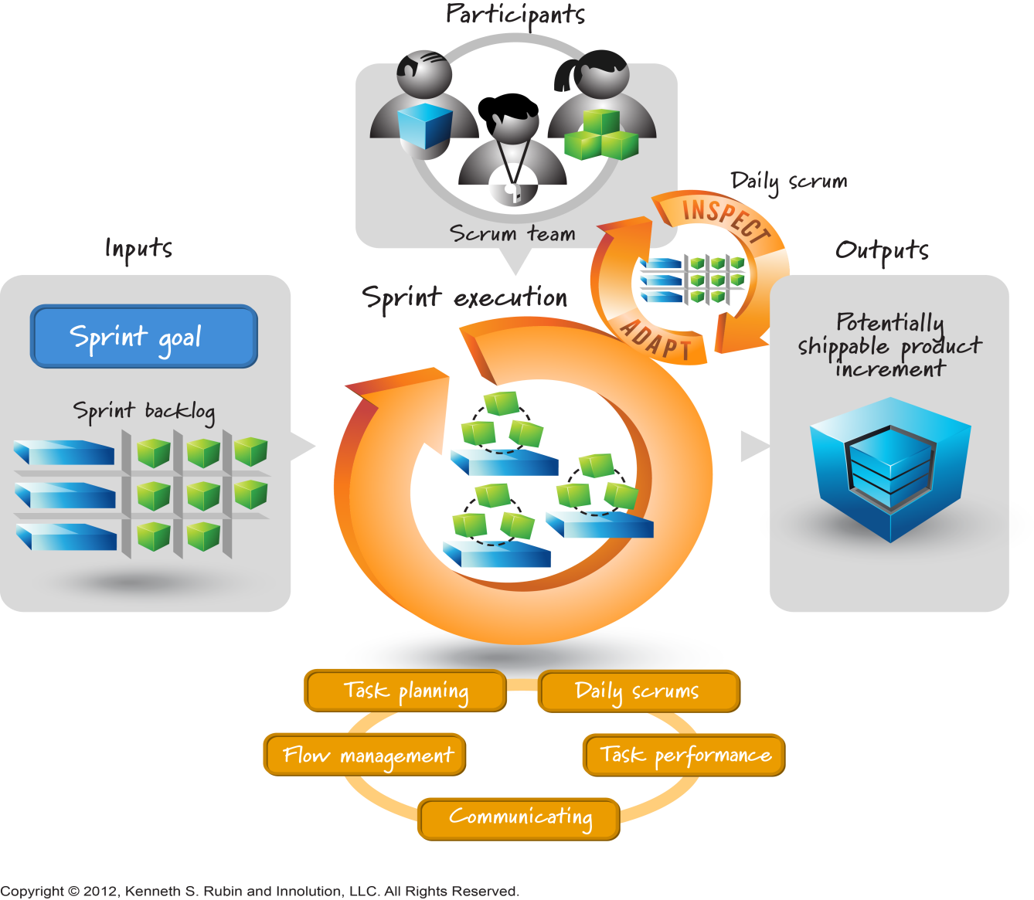
Sprint Execution
Whole Team
Paring
Swarming
Mob Programming
10/28/23
SE ZG544 S1-23-24 Agile Software Process

Slide 4
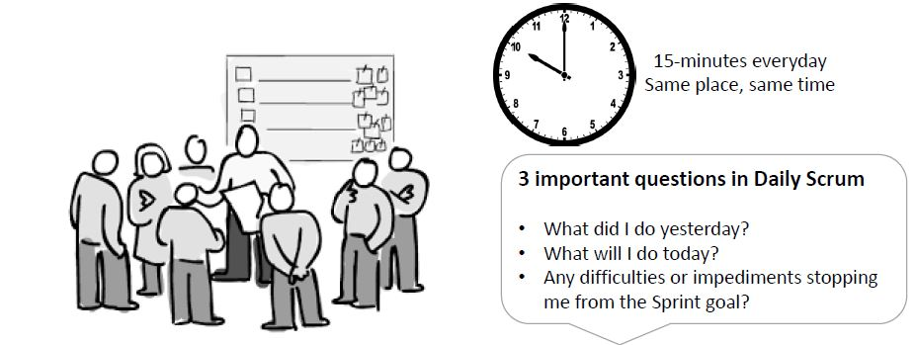
Daily Scrum
Dev. Team, Scrum master, Product Owner (Optional),
Ref: GenMan Solutions
10/28/23
SE ZG544 S1-23-24 Agile Software Process

Slide 5
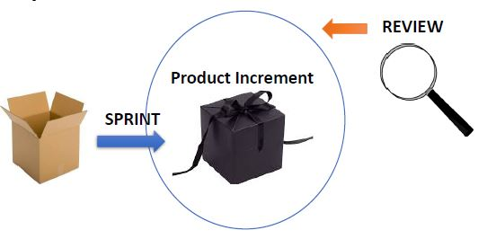

Sprint Review
Duration: Max 4 hrs. or less for 4 week sprint
Products invites all attendees
Development Team Demo the completed items.
Product owner verifies and lists completed and
incomplete items.
Development team share sprint experience
and highlights challenges.
The Product Owner updates the Product Backlog
and discusses the next sprint's activities.
Ref: GenMan Solutions
10/28/23
SE ZG544 S1-23-24 Agile Software Process

Slide 6
Sprint Retrospective
Agenda:
Set the stage, Gather Date ,Generate insights, Decide what to do, Close
Simplest Approach
Each team member is asked to identify specific things that the team should:
Start doing
Stop doing
Continue doing
Note:
Choosing Retrospective Topics
Use retrospective games, Videos, Movie
Use abstraction
Avoid-Technical and Management issues
Ref: Head First Agile by By Andrew Stellman and Jennifer Greene
10/28/23
SE ZG544 S1-23-24 Agile Software Process

Slide 7
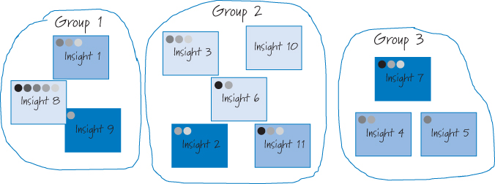
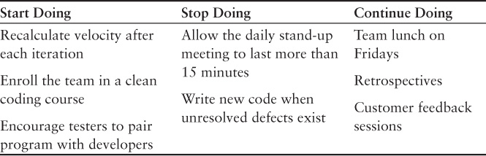
Sprint Retrospective
Group insights
Vote
Determine Actions
Ref: Essential Scrum: A Practical Guide to the Most Popular Agile Process by Kenneth S. Rubin Published by Addison-Wesley Professional, 2012
10/28/23
SE ZG544 S1-23-24 Agile Software Process

Slide 8
Communicating: The Progress
Information radiator
Self interpretable format
Task Board
Burndown charts
Burnup charts
10/28/23
SE ZG544 S1-23-24 Agile Software Process

Slide 9
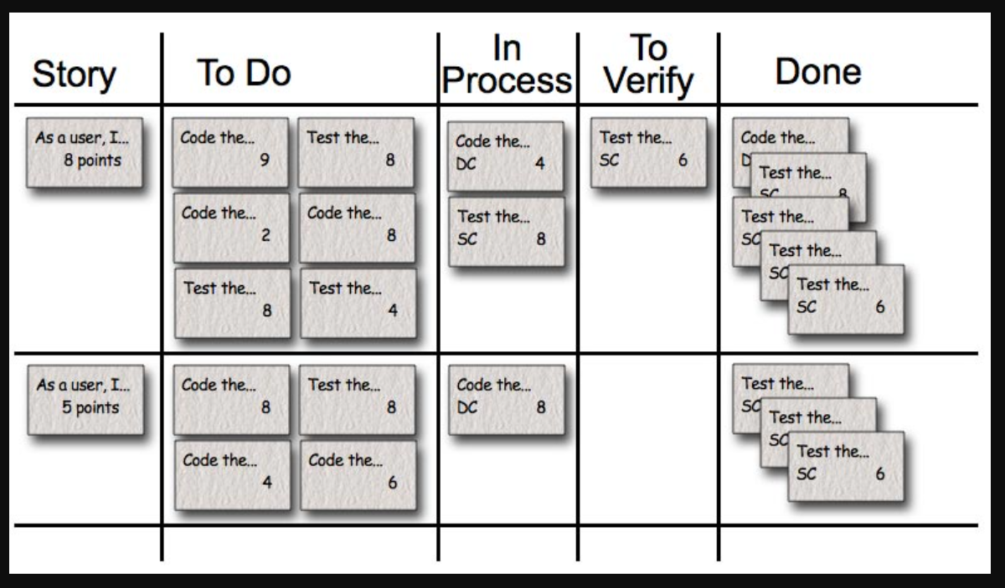
Sprint Task Board
Ref: Agile Estimation and Planning by Mike Cohn
10/28/23
SE ZG544 S1-23-24 Agile Software Process

Slide 10
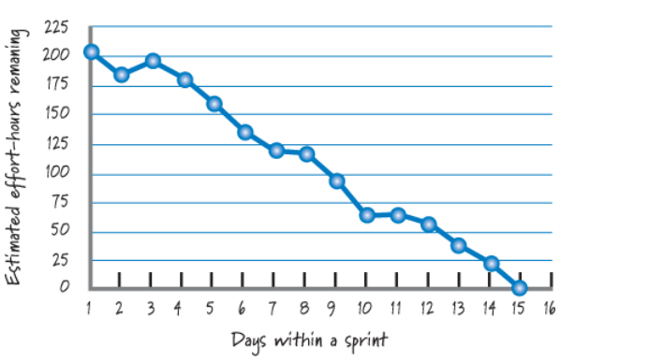
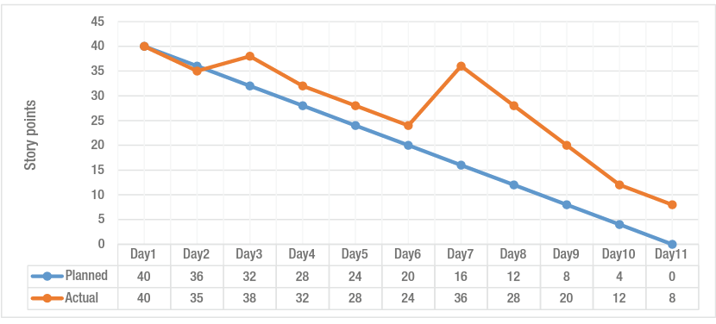
Sprint burndown chart
Ref: Essential Scrum: A Practical Guide to the Most Popular Agile Process by Kenneth S. Rubin Published by Addison-Wesley Professional, 2012

Slide 11
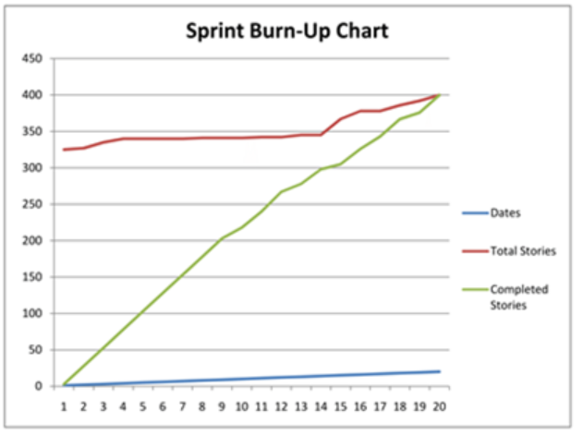
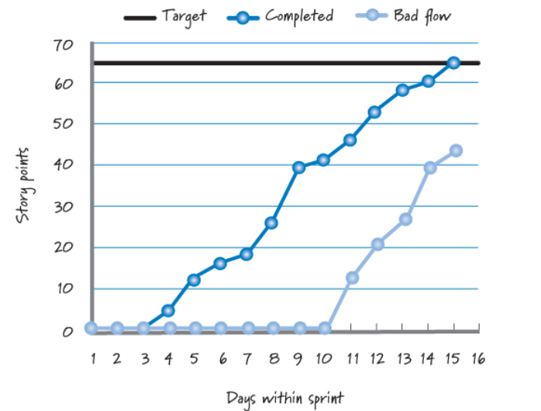
Sprint burnup
Story Points <> Days
The one advantage of burnup charts over burndown charts is that it can depict change of scope.
Ref: Essential Scrum: A Practical Guide to the Most Popular Agile Process by Kenneth S. Rubin Published by Addison-Wesley Professional, 2012
10/28/23
SE ZG544 S1-23-24 Agile Software Process

Slide 12
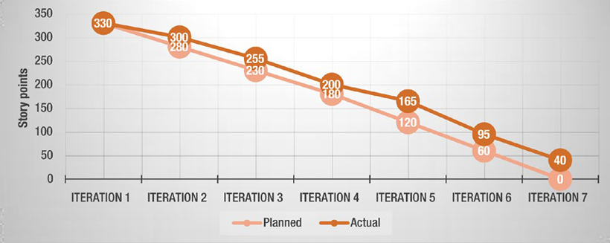
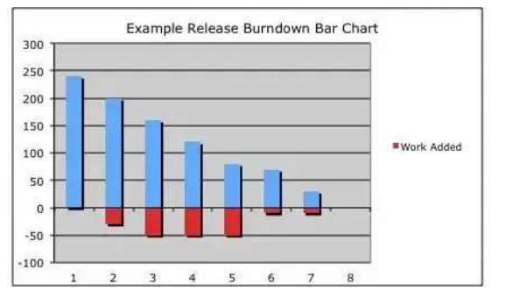
Release-Charts
Release Burndown chart
One dimensional view- Planned vs Actual
10/28/23
SE ZG544 S1-23-24 Agile Software Process

Slide 13
Quiz

Slide 14
Additional Notes
10/28/23
SE ZG544 S1-23-24 Agile Software Process

Slide 15
Sprint Execution: The Process
Task planning
No Gantt chart, Just-in-time, dependency planning (e.g. Stress testing)
Flow Management
Team responsibility to organize the flow work, what should be done next and in parallel. Don’t aim to make everyone 100% busy.
Parallel work and swarming
Which item to start? What Tasks Needs to Be Done? – Height priority/Value.
How to organize the work? - No hands-off approach, no artificial wall across boundaries (e.g. UX/ Business logic/Database).
Who does the work? – Person with appropriate skills.
Ref: Essential Scrum: A Practical Guide to the Most Popular Agile Process by Kenneth S. Rubin Published by Addison-Wesley Professional, 2012
Ref: Essential Scrum: A Practical Guide to the Most Popular Agile Process by Kenneth S. Rubin Published by Addison-Wesley Professional, 2012
10/28/23
SE ZG544 S1-23-24 Agile Software Process

Slide 16
Sprint burndown chart- Effort
Ideal line
X-Axis: Represents the days within a sprint.
Y-Axis: Remaining estimated effort-hours
Should be updated every day
Charts shows the trend – likelihood of completing the work by end of the sprint
Only shows the number of Story points/Efforts that have been completed. The burndown chart doesn’t show any changes in the scope of work. For that, We use burnup charts.
Ref: Essential Scrum: A Practical Guide to the Most Popular Agile Process by Kenneth S. Rubin Published by Addison-Wesley Professional, 2012
10/28/23
SE ZG544 S1-23-24 Agile Software Process

Slide 17
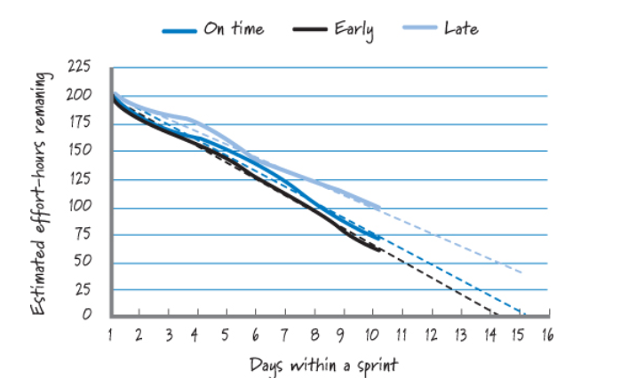
Sprint burndown chart with trend lines
Ref: Essential Scrum: A Practical Guide to the Most Popular Agile Process by Kenneth S. Rubin Published by Addison-Wesley Professional, 2012
10/28/23
SE ZG544 S1-23-24 Agile Software Process

Slide 18
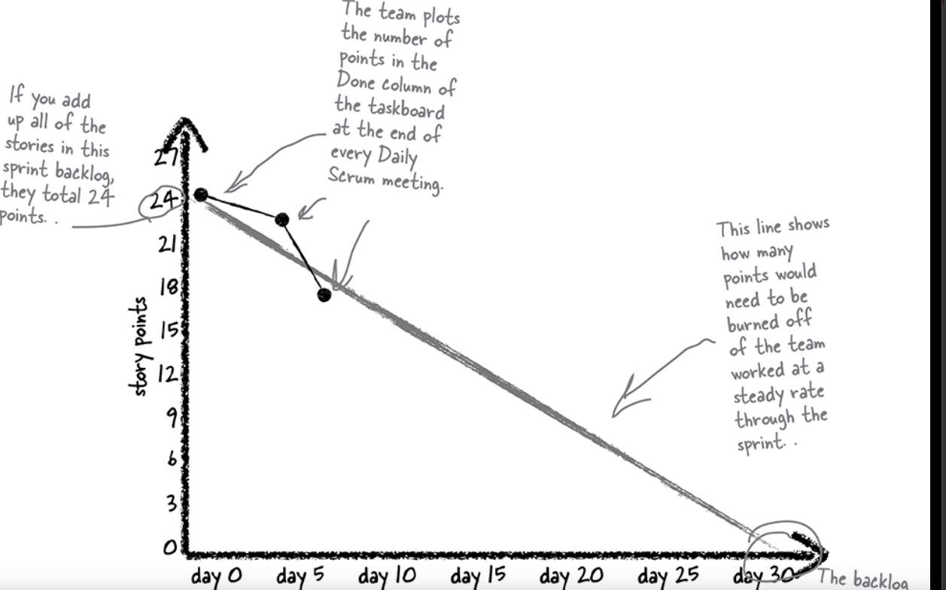
Sprint burndown chart- Story points
Ref: Head First Agile by By Andrew Stellman and Jennifer Greene
10/28/23
SE ZG544 S1-23-24 Agile Software Process

Slide 19
Sprint burnup chart
Many people prefer to use story points in their burnup charts, because it represents business value
The “Bad flow” line illustrates - the team starts too many product backlog items at the same time, doing too much work in parallel.
Works on product backlog items that are large and therefore take a long time to finish, or takes other actions that result in bad flow.
Ref: Essential Scrum: A Practical Guide to the Most Popular Agile Process by Kenneth S. Rubin Published by Addison-Wesley Professional, 2012
10/28/23
SE ZG544 S1-23-24 Agile Software Process

Slide 20
Sprint Execution: Daily Scrum team meeting
Daily Scrum – 15 minutes or less, held at the same time everyday. Not a problem solving meeting.
Also called daily standup to promote brevity.
ScrumMaster facilitating and each team member taking turns answering three questions for the benefit of the other team members:
What have I done since our last meeting?
What am I planning on doing between now and our next meeting?
What roadblocks are in my way?
The daily scrum is an inspection, synchronization, and adaptive daily planning activity that helps a self-organizing team do its job better.
Ref: Essential Scrum: A Practical Guide to the Most Popular Agile Process by Kenneth S. Rubin Published by Addison-Wesley Professional, 2012
10/28/23
SE ZG544 S1-23-24 Agile Software Process

Slide 21
Sprint Execution
Sprint execution is the work the Scrum team performs during each sprint to meet the sprint goal.
Performs all of the work necessary to deliver a potentially shippable product implement. The team's work is guided by the sprint goal and sprint backlog.
We shall focus on the principles and techniques that guide how the Scrum team plans, manages, performs, and communicates during sprint execution.
Ref: Essential Scrum: A Practical Guide to the Most Popular Agile Process by Kenneth S. Rubin Published by Addison-Wesley Professional, 2012
10/28/23
SE ZG544 S1-23-24 Agile Software Process

Slide 22
Sprint Execution: Timing
The majority of the team's time each sprint should be spent in sprint execution.
It begins after sprint planning and continues until the sprint review begins.
For a two-week sprint, sprint execution would likely count for 8 to 8.5 of the 10 days
Ref: Essential Scrum: A Practical Guide to the Most Popular Agile Process by Kenneth S. Rubin Published by Addison-Wesley Professional, 2012
10/28/23
SE ZG544 S1-23-24 Agile Software Process

Slide 23
Sprint Execution: Participants
During sprint execution:
The development team members self-organize to determine the best way possible to meet the sprint goal.
The ScrumMaster coaches, facilitates, and removes any impediments that block or slow the team's progress.
The product owner is available to answer questions, review intermediate work, and provide feedback to the team. The product owner might also be called upon to discuss adjustments to the sprint goal or to verify acceptance criteria.
The ScrumMaster doesn’t assign work to the team or tell the team how to do the work. A self-organizing team figures these things out for itself.
Ref: Essential Scrum: A Practical Guide to the Most Popular Agile Process by Kenneth S. Rubin Published by Addison-Wesley Professional, 2012
10/28/23
SE ZG544 S1-23-24 Agile Software Process

Slide 24
Sprint execution: Process
Task Planning
During sprint planning the team produces a high-level plan for how to achieve the sprint goal, usually in the form of a sprint backlog.
Team members perform just-in-time task-level planning as needed, as opposed to trying to formulate a detailed plan or Gantt chart.
Massive influx of learning comes from building and testing. This will disrupt even a well laid out plan.
However, some upfront planning helps in exposing the task level dependencies
Example: if a feature being developed to be subjected two day long stress testing. Develop the feature and plan for the test at least two days before the end of sprint execution.
10/28/23
SE ZG544 S1-23-24 Agile Software Process

Slide 25
Sprint execution: Process
Flow Management
It is the team's responsibility to manage the flow of work throughout the sprint to meet the sprint goal.
This includes making decisions about how much work the team should do in parallel, which work to start, how to organize the task-level work, which work to do, and who should do the work.
When answering these questions, teams should discard old behaviors, such as trying to keep everyone 100% busy believing that work must be done sequentially, and having each person focus on just her part of the solution.
Example: Don’t create artificial wall across technical boundaries (UX/Business logic/Backend work/Testing)
Sit together and discuss: How the work can accomplished iteratively and efficient way
Ref: Essential Scrum: A Practical Guide to the Most Popular Agile Process by Kenneth S. Rubin Published by Addison-Wesley Professional, 2012
10/28/23
SE ZG544 S1-23-24 Agile Software Process

Slide 26
Flow Management: Parallel Work and Swarming
The team must determine how many product backlog items to work on in parallel, in other words, at the same time. Working on too many items at once slows the team down. But working on too few items at once is equally wasteful. To find the proper balance, I recommend that teams work on the number of items that leverages but does not overburden the T-shaped skills and available capacity of the team members.
The goal is to reduce the time required to complete individual items while maximizing the total value delivered during the sprint. Another name for this approach is swarming. Swarming is when team members with available capacity work together to complete one unfinished item rather than moving ahead to work on new items. This doesn't mean teams should always work on only one item at a time—the actual number of open items at any one time is highly dependent on context. Teams will have to experiment to find the balance that maximizes the value they deliver each sprint.
Ref: Essential Scrum: A Practical Guide to the Most Popular Agile Process by Kenneth S. Rubin Published by Addison-Wesley Professional, 2012
10/28/23
SE ZG544 S1-23-24 Agile Software Process

Slide 27
Flow Management: Which Items to start
The simplest way to choose the product backlog item to work on next is to select the highest-priority item as specified by the product owner.
Unfortunately, this doesn't always work. In reality, dependencies or skills capacity constraints might dictate a different order. The development team should be enabled to opportunistically select work as appropriate.
Ref: Essential Scrum: A Practical Guide to the Most Popular Agile Process by Kenneth S. Rubin Published by Addison-Wesley Professional, 2012
10/28/23
SE ZG544 S1-23-24 Agile Software Process

Slide 28
Flow Management: How to Organize the work?
It's tempting for new agile teams to approach task level work in a waterfall fashion: design it, code it, and then test it.
It's better, however, to approach the work from a value and delivery-focused mindset.
This means minimizing the amount of time work sits idle and reducing the size of handoffs
In practice, this sometimes looks like a developer and tester pairing at the start of a task to work in a highly interleaved fashion, with rapid cycles of test creation, code creation, test execution, and test and code refinement. This approach keeps work flowing, supports very fast feedback, and enables team members with T-shaped skills to swarm on an item to get it done.
Ref: Essential Scrum: A Practical Guide to the Most Popular Agile Process by Kenneth S. Rubin Published by Addison-Wesley Professional, 2012
10/28/23
SE ZG544 S1-23-24 Agile Software Process

Slide 29
Flow Management: What tasks need to done?
The team should decide which task-level work it needs to perform to complete a product backlog item. Product owners and stakeholders influence these choices by defining the scope of a feature and creating acceptance criteria.
They also provide business-facing requirements for the team's definition of done. Overall, the team and the product owner must work together to ensure that technical decisions with important business consequences are made in an economically sensible way.
Ref: Essential Scrum: A Practical Guide to the Most Popular Agile Process by Kenneth S. Rubin Published by Addison-Wesley Professional, 2012
10/28/23
SE ZG544 S1-23-24 Agile Software Process

Slide 30
Flow Management: Who does the work?
Who should work on each task? An obvious answer is the person best able to quickly and correctly get it done. And if that person is unavailable, the team should decide on the next best person.
Ref: Essential Scrum: A Practical Guide to the Most Popular Agile Process by Kenneth S. Rubin Published by Addison-Wesley Professional, 2012
10/28/23
SE ZG544 S1-23-24 Agile Software Process

Slide 31
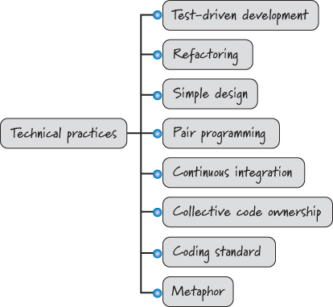
Task Performance: Technical Practices
Development team members are expected to be technically good at what they do.
Most teams achieve the long-term benefits of Scrum only if they also embrace strong technical practices when performing task-level work.
Ref: Essential Scrum: A Practical Guide to the Most Popular Agile Process by Kenneth S. Rubin Published by Addison-Wesley Professional, 2012
10/28/23
SE ZG544 S1-23-24 Agile Software Process

Slide 32
Communicating: The Progress
Most teams use a combination of a task board and a burndown and/or burnup chart as their principal information radiator.
Information radiator:
A visual display that presents up-to-date, sufficiently detailed, and important information to passersby in an easy, self-interpretable format.
Ref: Essential Scrum: A Practical Guide to the Most Popular Agile Process by Kenneth S. Rubin Published by Addison-Wesley Professional, 2012
10/28/23
SE ZG544 S1-23-24 Agile Software Process

Slide 33
Thank you

